Slide 1

Project 3: Classification of 2 Subreddits: Makeup & Fragrance
Siti Alawiyah

Slide 2
AGENDA
1
3
4
5
Problem Statement
2
Process
3
EDA
Modelling
Results

Slide 3
01
PROBLEM STATEMENT

Slide 4
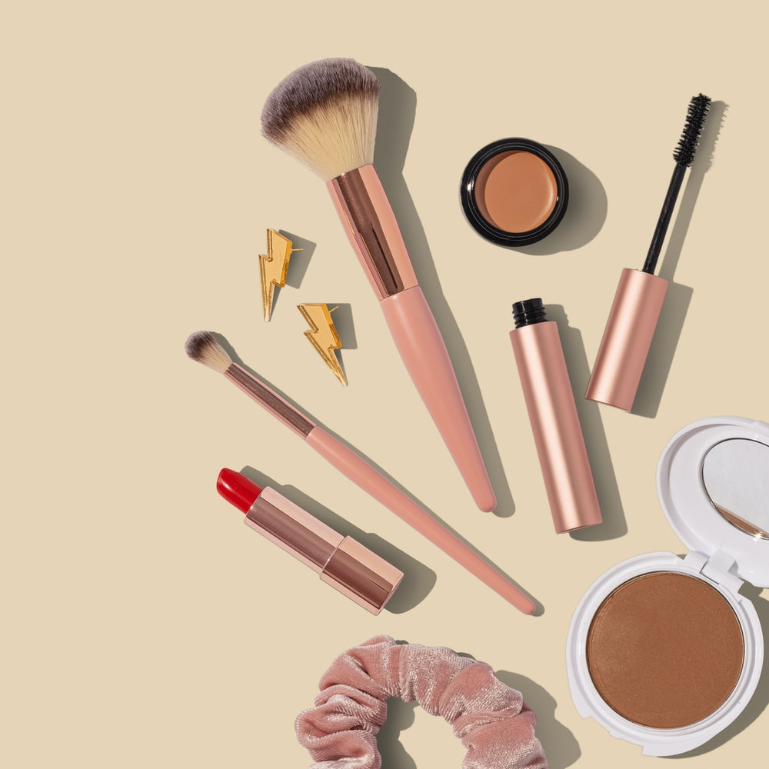
Problem Statement
Use Pushshift API to collect 2 subreddits category: makeup and fragrance
Use NLP to train a classifier on which subreddit a post has been given to

Slide 5
02
PROCESS

Slide 6
Process
Entries Scrapped
Selected Columns:
Null Values Dropped:
Makeup: 1100 entries
Fragrance: 1100 entries
Title
Subreddit
Selftext
Makeup: 62
Fragrance: 12
EDA
Check for Info:
Duplicates Dropped:
Makeup: 1038 entries
Fragrance: 1086 entries
Makeup: 0
Fragrance: 2

Slide 7
03
EDA

Slide 8
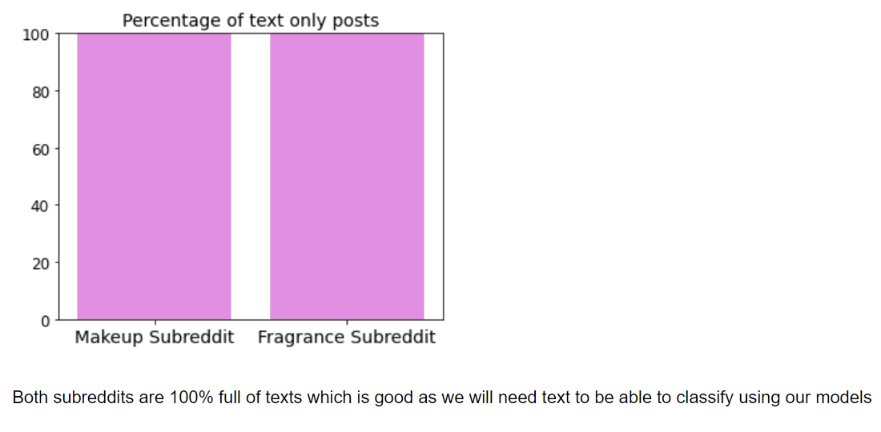
Texts only posts

Slide 9
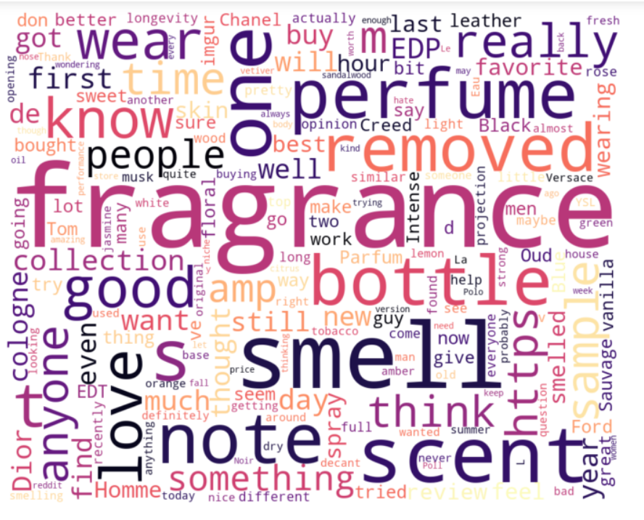
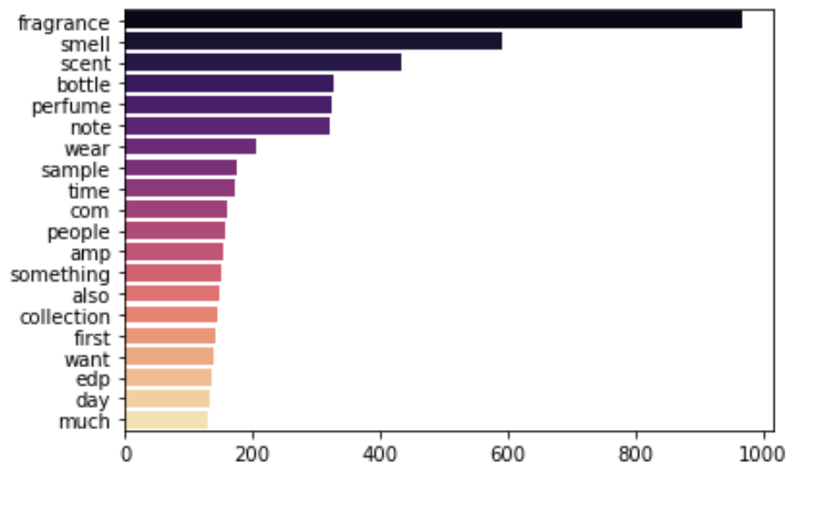
Top words for Fragrance Subreddit

Slide 10
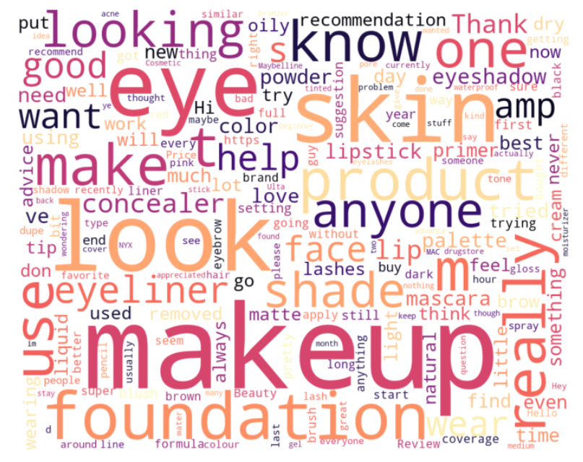
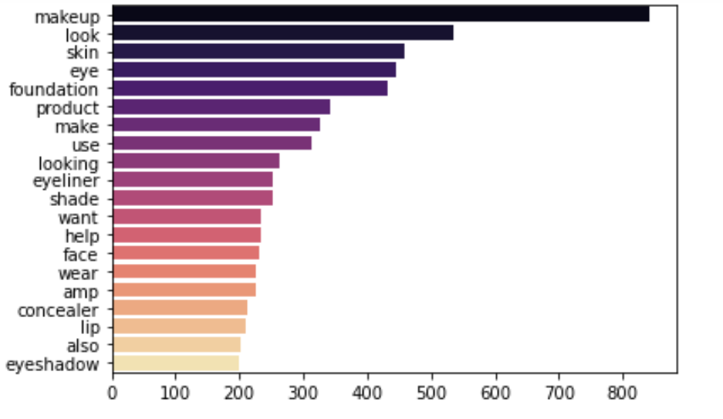
Top words for Makeup Subreddit

Slide 11
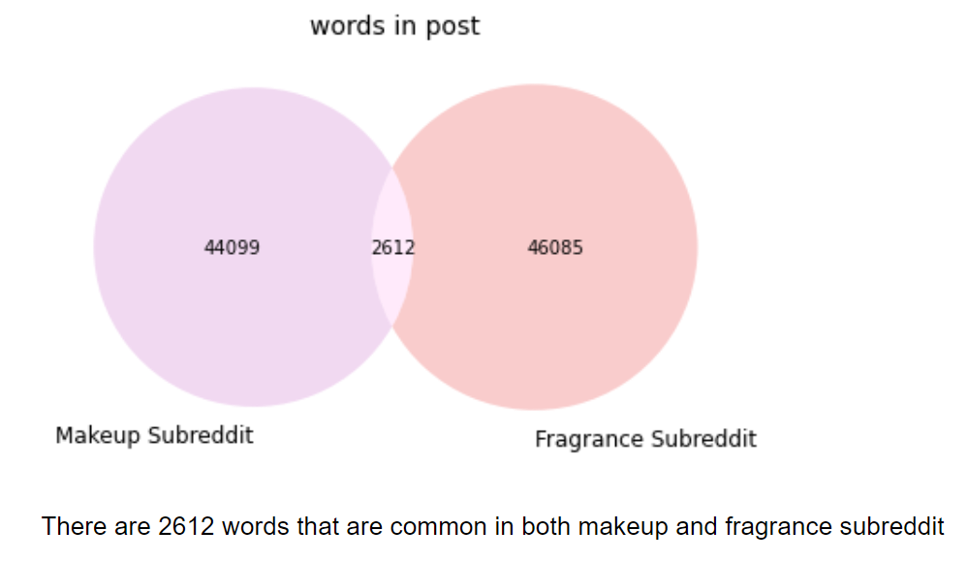
Common Words in Subreddits

Slide 12
04
Modelling

Slide 13
Pre-Modelling Process
1.
2.
3.
Combine: Selftext and Title into 1 column called message
Drop unnecessary columns
Columns left: Subreddit, Message
Preprocess
6.
5.
4.
Split the data into training and testing sets
70% training set
Select X and y columns
X = df[‘message']
y = df['subreddit']
Convert the subreddit to binary labels:
0: Fragrance
1: Makeup
Notes:
Change to lowertext cases, lemmatize, remove special characters, remove weblinks, numbers, stopwords. I also decided to remove words such as fragrance and makeup as these 2 words are obvious to the subreddit.

Slide 14
Types of Models
 | RandomForestClassifier | Naïve Bayes
Pipeline | CountVectorizer, RandomForestClassifier (random_state=42) | ("vec", None), ("model", MultinomialNB())
PipeParameters | 'cvec__max_features': [800, 900, 1_000], 'cvec__stop_words': [None, "english"], 'cvec__min_df': [2, 3], 'cvec__max_df': [.9, .95], 'cvec__ngram_range': [(1, 1),(1, 2),(2,3)], 'rf__n_jobs': [-1], 'rf__n_estimators': [100,150,200], 'rf__max_depth': [None, 1, 2, 3, 4, 5, 6], | "vec": [CountVectorizer(), TfidfVectorizer()], 'vec__max_features': [800, 900, 1_000], 'vec__stop_words': [None, "english"], 'vec__min_df': [2, 3], 'vec__max_df': [.9, .95], 'vec__ngram_range': [(1, 1),(1, 2),(2,3)]
GridSearchCV | cv =3, scoring = AUC, accuracy | cv=3, scoring = AUC, accuracy
Notes:
My pipeline for RF is to transform it with Countvec and then the estimator which is RF. In the pipeparametes, I set a range of parameters that are available in count vec as well the estimator. The parameters highlighted in grey are the different parameters that I tried that is different to the model I have chosen. Then I put it in gridsearch with cross validation =3 and the scoring metrics chosen is AUC and accuracy as the objective of the project is to see if my classifier is able to classify which subreddit a post has been given to. The Area Under the Curve (AUC) is the measure of the ability of a classifier to distinguish between classes and is used as a summary of the ROC curve. The higher the AUC, the better the performance of the model at distinguishing between the positive and negative classes.

Slide 15
05
Results & Conclusion

Slide 16
Scores
RF
NB
AUC Train Score | 0.987 | 0.994
AUC Test Score | 0.977 | 0.989
Accuracy Train Score | 0.905 | 0.954
Accuracy Test Score | 0.887 | 0.933

Slide 17
Best Parameters
Best Params | RF Classifier | NB
Cvec max df | 0.9 | 0.9
Cvec max features | 1000 | 1000
Cvec min df | 3 | 3
Ngram_range | 1,1 | 1,1
Stopwords | english | english
Max depth | 6 | -
N estimators | 200 | -
Top Features: | Look, smell, eye, foundation, perfume, scent, bottle, eyeshadow, face, concealer
Notes:
Countvectorizer is a better transformation and the parameters for both classifier gave the same results as shown. In my randomforest model, it shows that best max depth is 6 and the estimators is 200. I also took out the top 10 features as the rf classifier is able to do so. The top 10 features are a mixed of words that significantly be able to tell us if it is from a fragrance subreddit or a makeup subreddit.

Slide 18
Conclusion
All models can classify which subreddit a post has been given to.
Best model recommendation: Naive Bayes
difference between the test/training AUC score and accuracy score is approximately 0.01
AUC score and accuracy score is also the highest
Future steps: explore other models such as GradientBoost. Try removing the top features and see if the classifiers are able to classify accurately.

Slide 19
THANK YOU!

